Slide 1
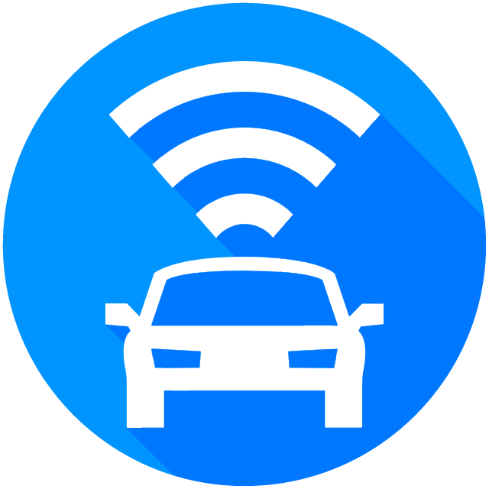
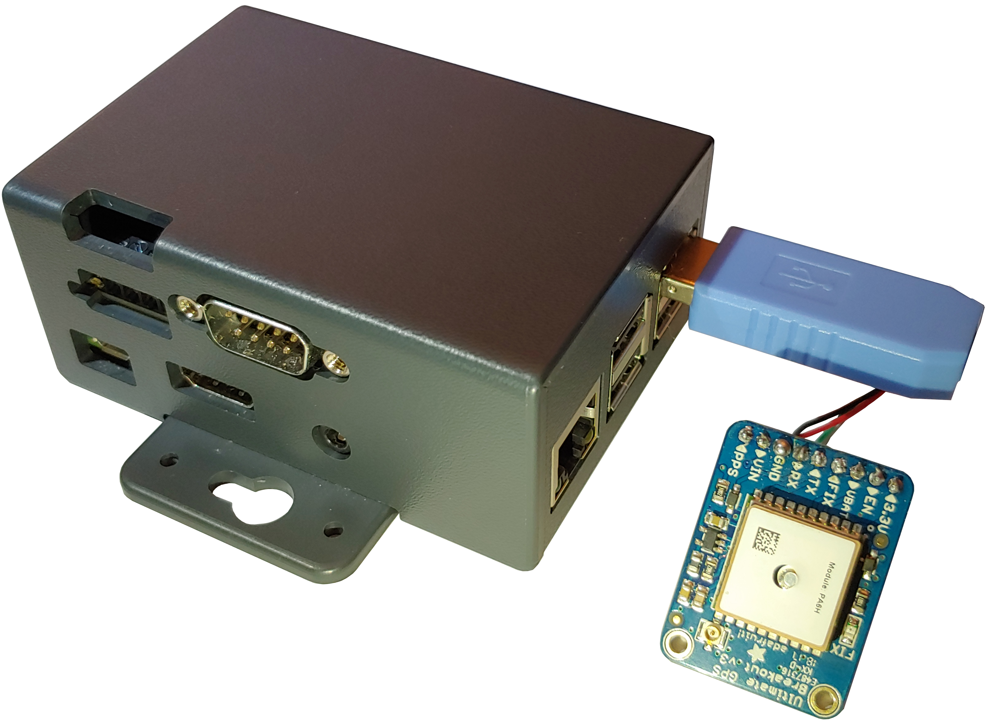
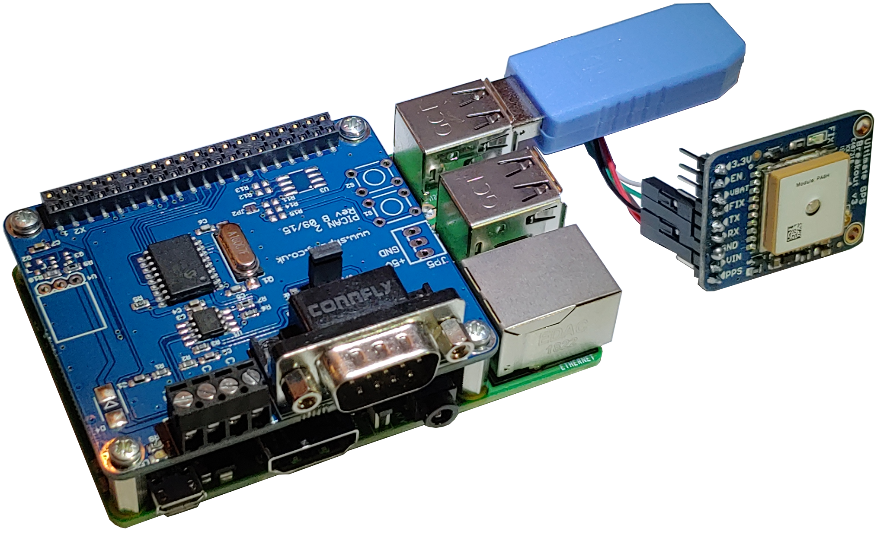

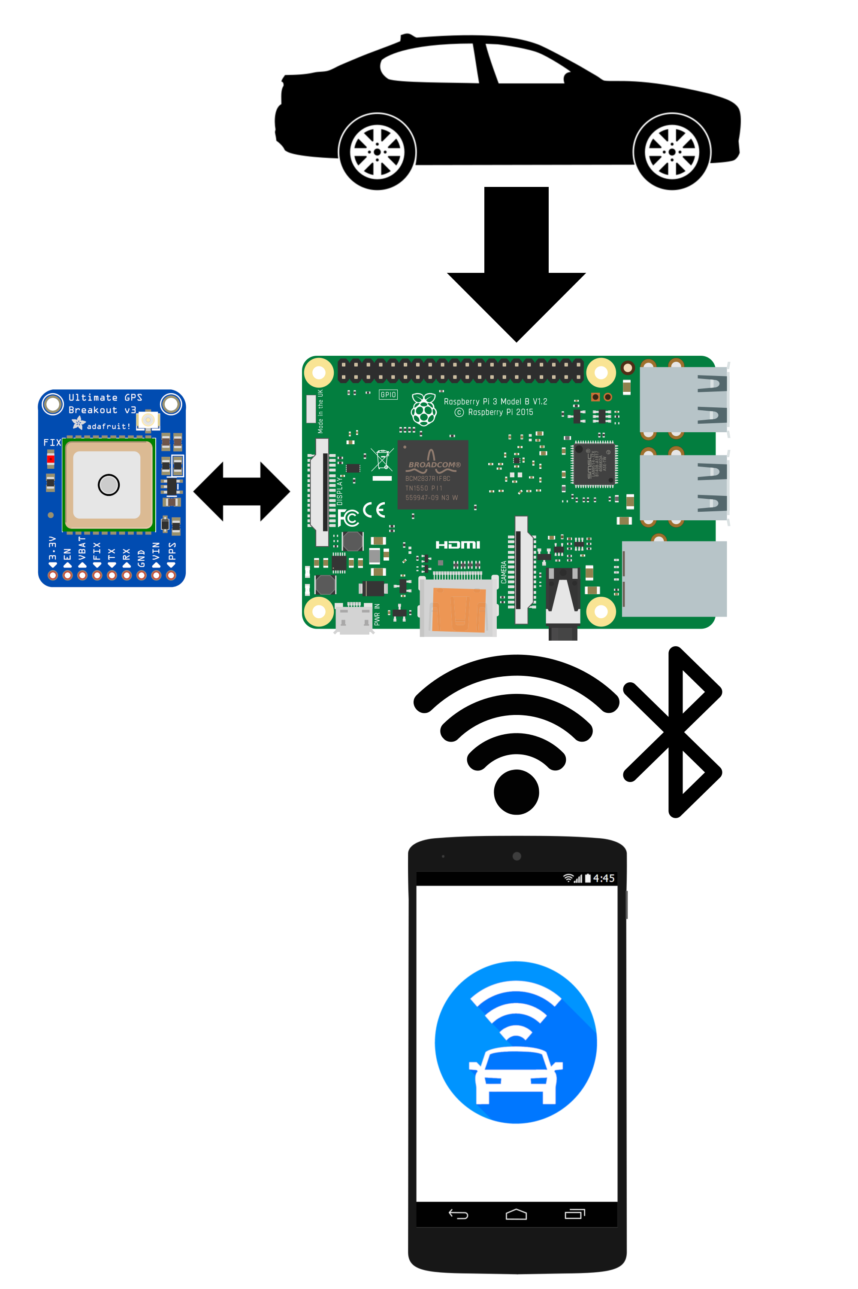
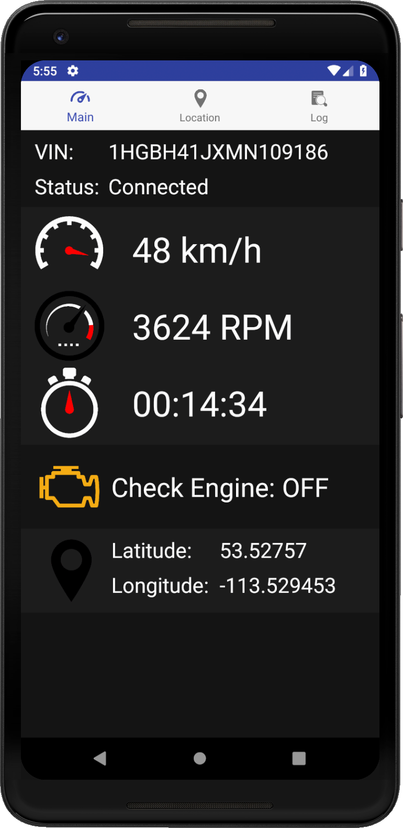
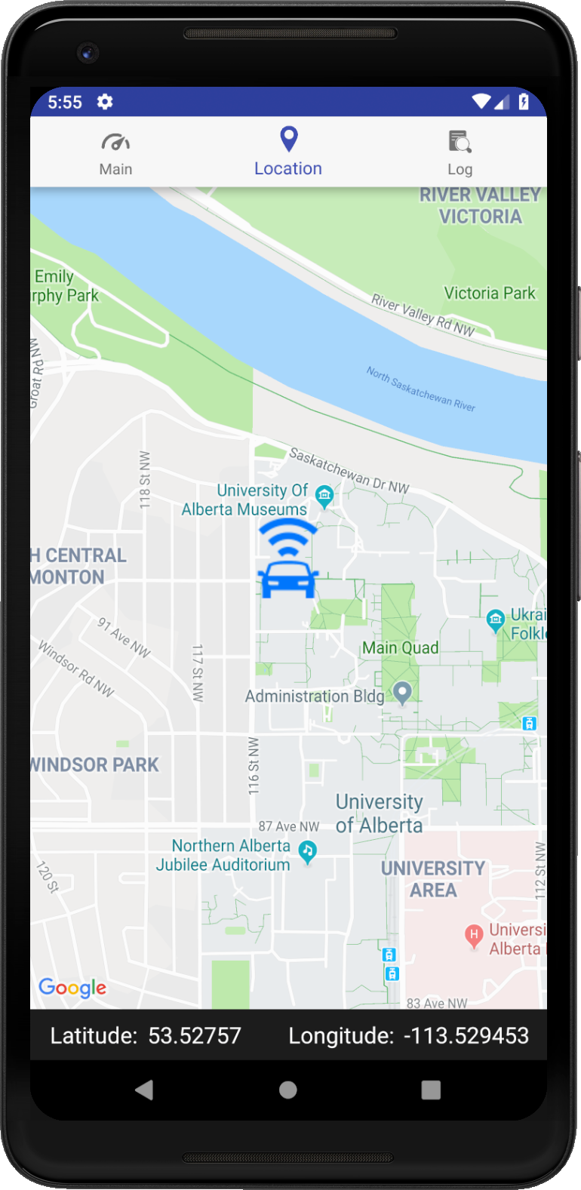
ECE 492 Capstone Design Project
Smart Automatic Vehicle Locator
Design Group Members | Client | Technical Advisor | Year
Nicholas Hoskins, Riley Dixon, Adrian Schuldhaus | Latium Fleet Management | Dr. Edmond Lou | 2018-19
Project Objective
A challenge for a company which manages a large fleet of vehicles is tracking each vehicle and its current location and status. The Smart Automatic Vehicle Locator (SmartAVL) is a system that begins to solve this challenge, by allowing a remote user access to near real time data of a vehicle in their fleet.
Additionally, the SmartAVL system also meets the requirements of operating in Edmonton’s cold winters, and being contained in a small form factor as to not interfere with the operation of the vehicle.
Android App Overview
The Android App has three main activities to present to the user.
The first activity, as shown in Fig. 2, is an overview of the vehicle and selected data to display to the user. The data shown can be modified by changing what the Raspberry Pi looks for from the CAN messaging service.
Secondly, there is a map activity (Fig. 3) that allows the user to see where the vehicle is in real-time. This data is pulled from the Adafruit GPS that is connected to the Raspberry Pi which is refreshed every second.
Lastly, there is an activity to see a log of data sent to the Android App.
Fig. 4: The Raspberry Pi in its enclosure. | Fig. 5: Breakdown of the Raspberry Pi
PiCAN 2 Interface
Adafruit Breakout GPS
High Impact Polystyrene Enclosure
DB-9 Port to OBD-2 Port
Raspberry Pi 3 B+
Raspberry Pi Overview
The core of SmartAVL is a Raspberry Pi and the PiCAN 2 Interface that is connected to the vehicle via the OBD-2 port. Data is received from the vehicle’s ECU from the OBD-2 port to the PiCAN2 Interface where it is serialized. Once serialized, the data is passed to the Raspberry Pi where it is then processed and packaged with location data from the GPS before being forwarded to the Android app via Bluetooth.
The Raspberry Pi was selected for a number of reasons:
Flexibility of supporting numerous hardware peripherals as well as the generous number of ports.
The ability to run a flavour of Linux designed specifically for the Raspberry Pi.
Wide hardware and software support from the Raspberry Pi and Linux communities.
Its small form factor.
Expansion Goals
Add a cellular transceiver to facilitate communication over an LTE network.
Create a web server where data is sent to and retrieved from on the cloud.
Redesign how the GPS is connected.
Analytics and maintenance tracking.
Reduce the cost of the device further.
Data is sent from the vehicle and collected by the Raspberry Pi
The GPS data is updated every second and sent to the Raspberry Pi
Acknowledgements
Our group would like to thank Latium Fleet Management for sponsoring this project. Additionally, we would like to thank Dr. Edmond Lou, Raza Bhatti, Keith Mills, Raju Macgupalli, and Rick McGregor for their support and technical expertise lent to us throughout the development of the project.
After parsing the data, it is forwarded to the app via Bluetooth.
References
Please scan the QR code to view the GitHub repository for our project on: github.com/aschuldhaus/SmartAVL
Fig. 2: Overview display of the monitored vehicle | Fig. 3: The map activity showing the current location of the vehicle.
Fig. 1: The overview of the SmartAVL system
Department of Electrical & Computer Engineering
Notes:
For colour ideas, University Visual Identity Guidelines can be found here: http://www.toolkit.ualberta.ca/VisualIdentityGuidelines.aspx
1

